Slide 1
Spotify + Student + Emotion
Kenzi Lamberto (1654201)
Supervised by Amanda Belton and Daniel

Slide 2
SPOTIFY
UNWRAPPED
Stage 2
Aggregation and visualisation
Stage 3
Augment with sensemaking data
Spotify
Data
Interview
Data
We are here
Mediaflux
Stage 1
Researcher
Spotify
Data
Participant
Collection
Donated data merged into db
Transcribe
Local data
MRC Server
Researcher
Collect
Spotify data
Viz
Extract
Data returned as viz for sensemaking before interview
Participant
Mediaflux
Stage 4
Viz
Viz
Analysis and dissemination
Stakeholder
Extract
Data store
Analyse
Data flow
Researchers
name
Sharable data
Disseminate
Interview
Data
Spotify
Data
Name
Activity

Slide 3
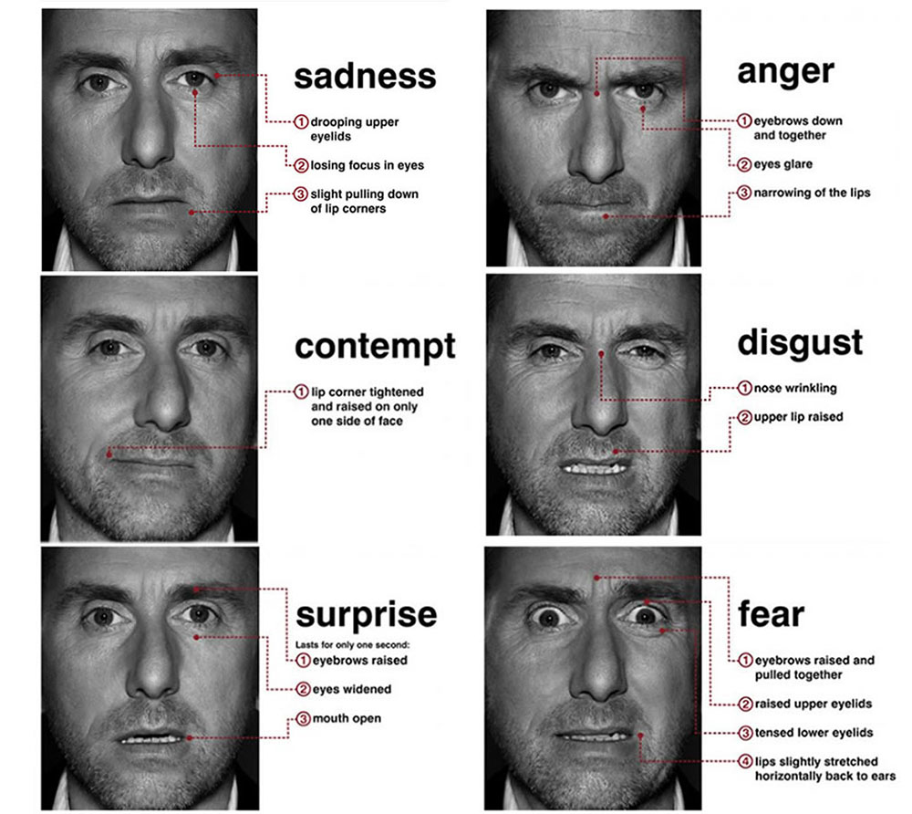
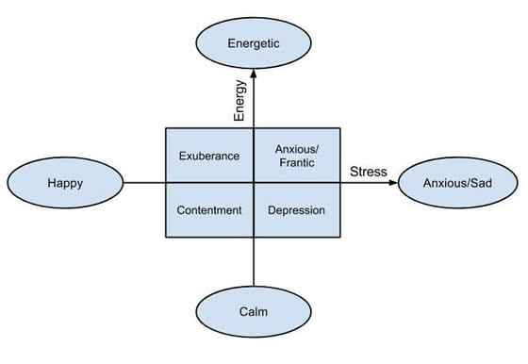
Emotion Datasets for Spotify songs
Ekman-style
Thayer-style
No Spotify Premium account, so no access to Spotify Web API
Current Solution: Kaggle! (but Spotify Web API is better)
Divided to Joy and Love
Ekman (lyrics heavy): https://www.kaggle.com/datasets/devdope/900k-spotify/data?select=final_milliondataset_BERT_500K_rev…
Thayer (audio metadata heavy): https://www.kaggle.com/datasets/abdullahorzan/moodify-dataset?select=278k_labelled_uri.csv
Notes:
Ekman papers: https://aclanthology.org/D18-1404/, arxiv.org/abs/1910.10683 Thayer paper: https://ieeexplore.ieee.org/document/6754902

Slide 4
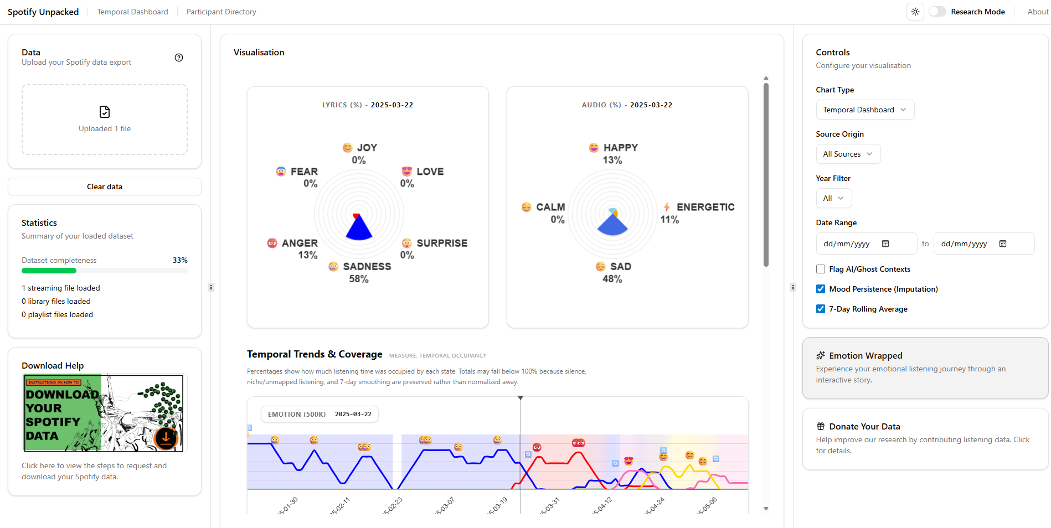
Temporal Dashboard: "rhythm" of a student's life

Slide 5
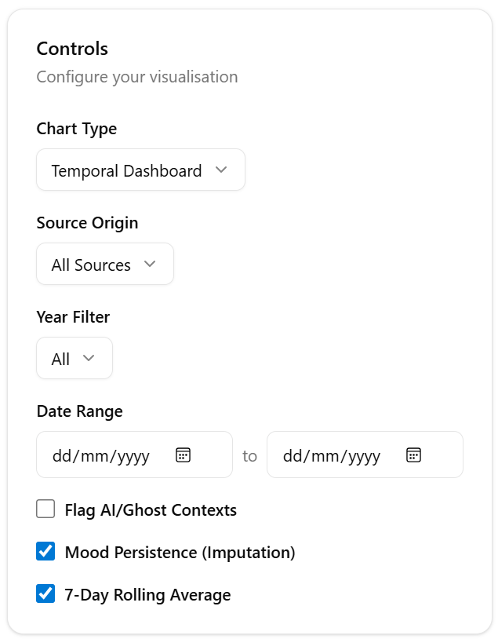
Temporal Dashboard
More types in progress
Date filter (working)
In-progress
On by default
Emotion imputation based on nearest neighbours
7-Day Rolling Average

Slide 6
Temporal Dashboard
Upload JSON files:
Streaming_History_Audio files (important)
Library file
Playlist file
Learn how to
Download
Spotify Data

Slide 7
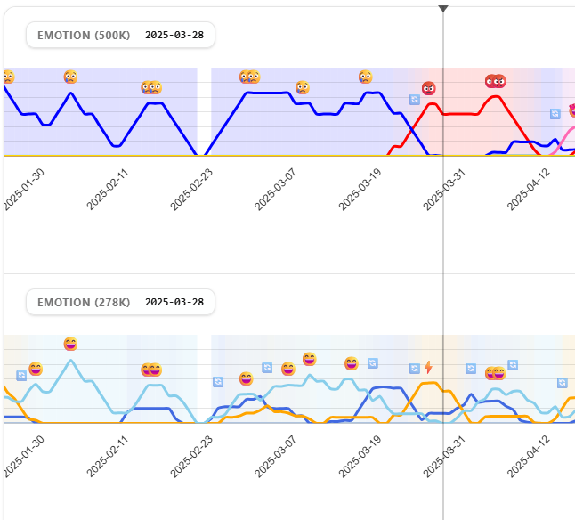
Temporal Dashboard
Ekman-style
Thayer-style
Emotions based on detected songs
What is used?
Ekman: track name + artist name (can use ISRC if we have Spotify Web API)
Thayer: Spotify URI

Slide 8
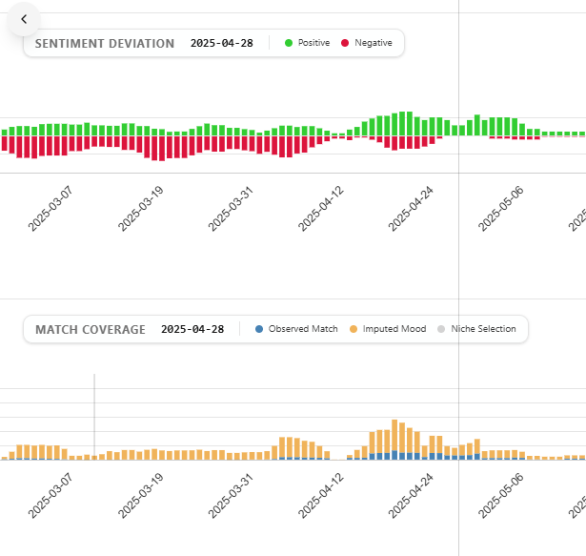
Temporal Dashboard
Sentiment Deviation: track Positive or Negative sentiment of the listened songs
Match Coverage: shows percentages of matched songs

Slide 9
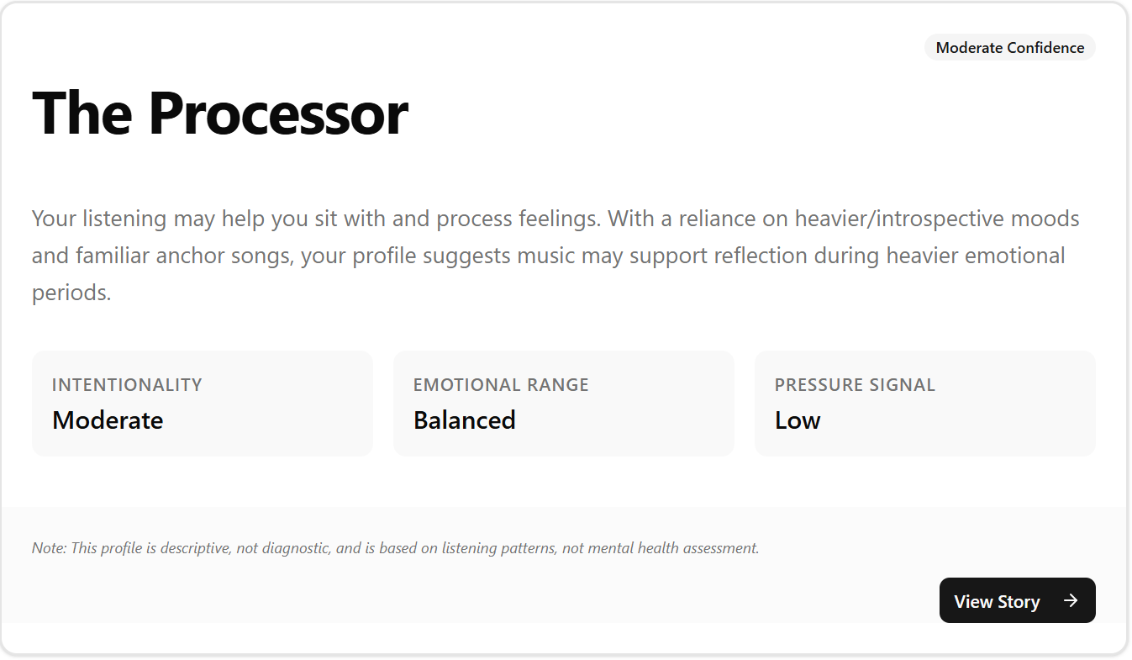
Aggregations and Wrapped: Data to Identity
Temporal tracking reveals rhythms, not reasons.
Need to translate timestamps and peaks into psychological insights.
Goal: Shift from technical data exploration to identity-facing narratives.

Slide 10
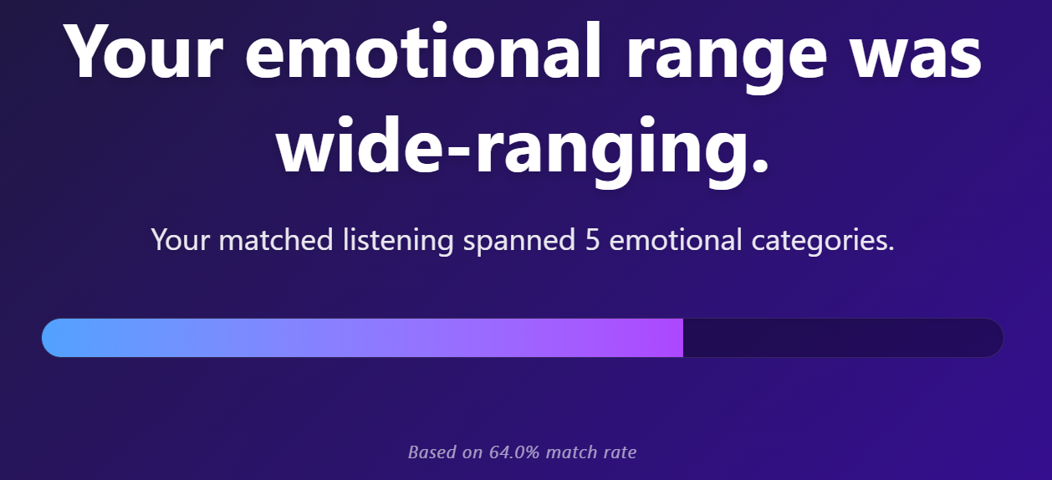
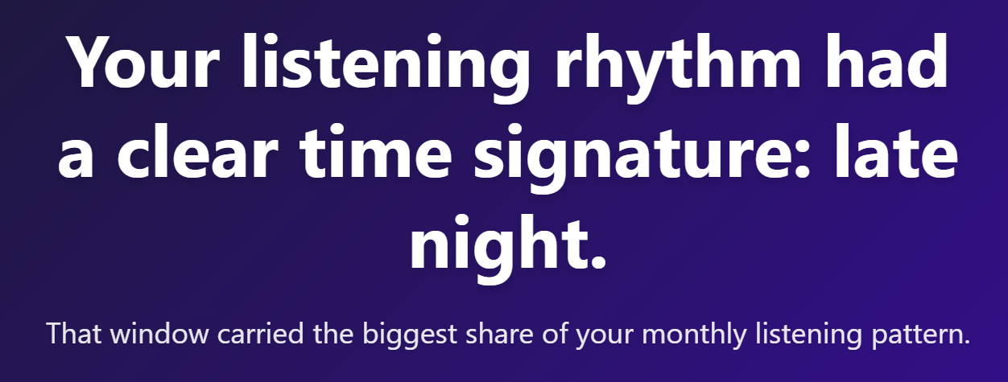
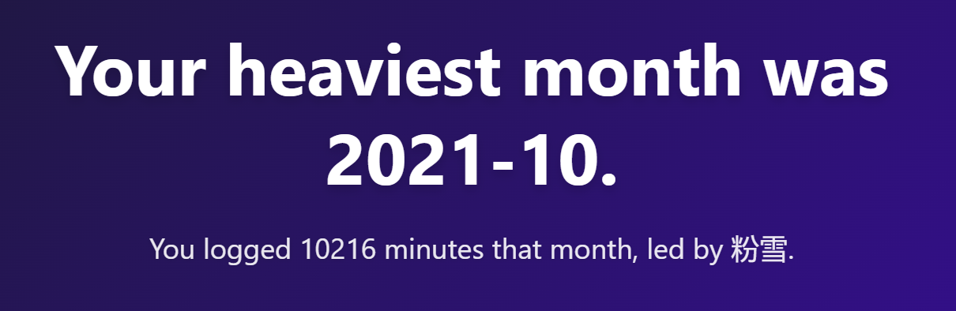
Aggregations and Wrapped
Aggregated data into 'Spotify Wrapped'-style story cards.
Created sub-bands to measure behaviors rather than just listening volume

Slide 11
Aggregations and Wrapped
Emotional Dimensions
Heavy Share (heavy_share): The proportion of listening allocated to sad, fearful, or low-valence music. Captures Affective Processing, deliberate behavioral choice to engage with complex, difficult feelings for introspection.
Upbeat Share (upbeat_share): The proportion of listening allocated to joyful or high-arousal music. Indicates Mood Repair (mood-lifting or resetting).
Emotional Diversity: Count of distinct emotion categories used. Indicates flexibility in coping strategies.
Intentionality Score: High repeat count + low playlist reliance. Indicates Regulatory Agency (deliberate, active selection).
Notes:
"Our metrics are fundamentally grounded in emotion regulation theory. When we look at 'Heavy Share,' we aren't just identifying 'sad' music; we are observing 'Affective Processing’, the choice to sit with a feeling. 'Upbeat Share' represents 'Mood Repair’, the active effort to lift oneself up. Perhaps most importantly, the 'Intentionality Score' ensures we are measuring deliberate, agentic choices rather than just passive background noise generated by Spotify's autoplay."

Slide 12
Aggregations and Wrapped
Behavioral Complexity
Emotional Diversity: Count of distinct emotional categories within a user's dataset.
Emotion Entropy (_exp): A Shannon Entropy score measuring the mathematical spread across all accessed emotional states. Quantifying how fluidly a user transitions between moods.
Daypart Concentration (_tail): A Herfindahl-Hirschman Index (HHI) score measuring the dominance of specific times of day. Detecting if music is heavily deployed to manage or survive specific daily routines (e.g., late-night study blocks).
Notes:
"We also needed to measure psychological complexity. 'Emotional Diversity' tells us the size of their toolkit, but 'Emotion Entropy' tells us how fluidly they use it. Do they adapt to different situations, or do they get stuck in an emotional rut? Meanwhile, 'Daypart Concentration' helps us spot students who rely on music to structure their day, for example, deploying music exclusively to survive intense, late-night study sessions."

Slide 13
Aggregations and Wrapped
Stress and Stability
Exam Tail Ratio: The proportional surge in listening minutes during academic exam months versus non-exam baselines. Captures High-Pressure Coping on auditory regulation during acute academic stress windows.
Anchor Exposure: The percentage of a student's total listening footprint occupied by their single most-played track. Captures the degree to which a student relies on a singular, highly familiar track to self-soothe or establish a predictable baseline..
Match Coverage: The percentage of total listening history that successfully maps to our emotional reference database. Acting as our Methodological Validity.
Notes:
"Finally, we analyze how students react to pressure and seek stability. The 'Exam Tail Ratio' is a direct measure of academic stress response, does music become a crutch during finals? 'Anchor Exposure' identifies students who find deep psychological safety in repetition, returning to a single track to ground themselves. And finally, 'Match Coverage' is our honesty check, ensuring we never draw conclusions if we can't 'read' enough of their data."

Slide 14
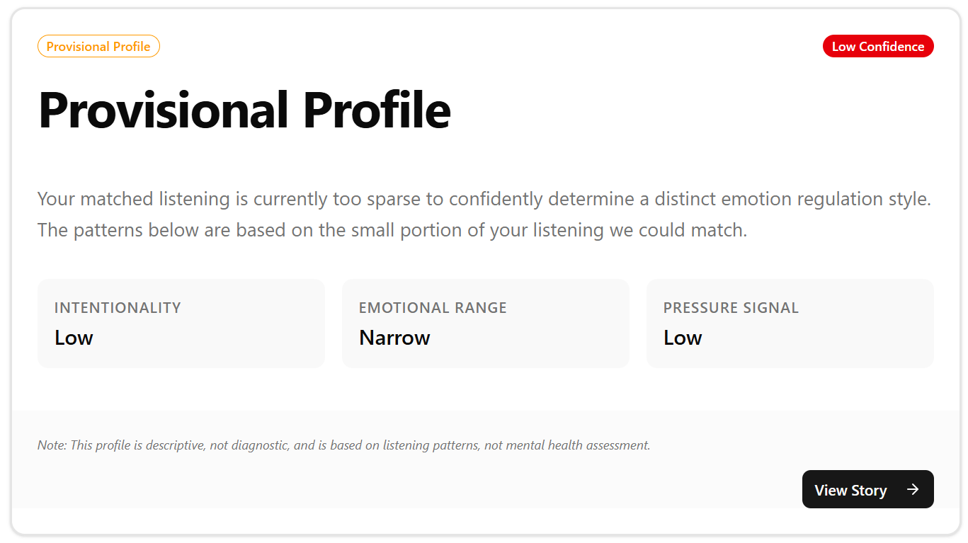
Aggregations and Wrapped
The Danger of Thin Data
High percentages do not always mean high confidence.
The Sparsity Problem: 8 minutes of "Sad" music out of 10 total matched minutes = 80% Sadness.
Risk: False-positive psychological labeling based on insufficient exposure.
Notes:
“Sparsity. If we only match 10 minutes of a student's listening history, and 8 of those minutes are 'Sad', they look like a highly introspective listener on paper. But drawing psychological conclusions from 10 minutes of data is irresponsible. We needed a way to measure our confidence in the data."

Slide 15
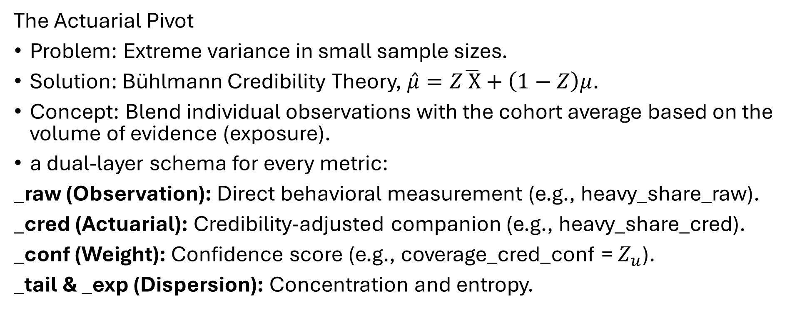
Aggregations and Wrapped
The Actuarial Pivot
Problem: Extreme variance in small sample sizes.
Solution: Bühlmann Credibility Theory, $\hat{μ}=Z\overline{ X}+\left(1−Z\right)μ$.
Concept: Blend individual observations with the cohort average based on the volume of evidence (exposure).
a dual-layer schema for every metric:
_raw (Observation): Direct behavioral measurement (e.g., heavy_share_raw).
_cred (Actuarial): Credibility-adjusted companion (e.g., heavy_share_cred).
_conf (Weight): Confidence score (e.g., coverage_cred_conf = $Z_{u}$).
_tail & _exp (Dispersion): Concentration and entropy.
Notes:
"This is the core formula. The adjusted score we use for classification is a blend. If we have high confidence in the student's data, $Z_u$ is high, and their raw data wins the tug-of-war. If confidence is low, $Z_u$ is low, and their score shrinks back toward the cohort average. We implemented a 'Dual-Layer' schema. Every major metric has a _raw suffix representing exactly what we observed, and a _cred, _tail, or _exp suffix representing the actuarial companion. This allows the frontend to compare the two states directly.”

Slide 16
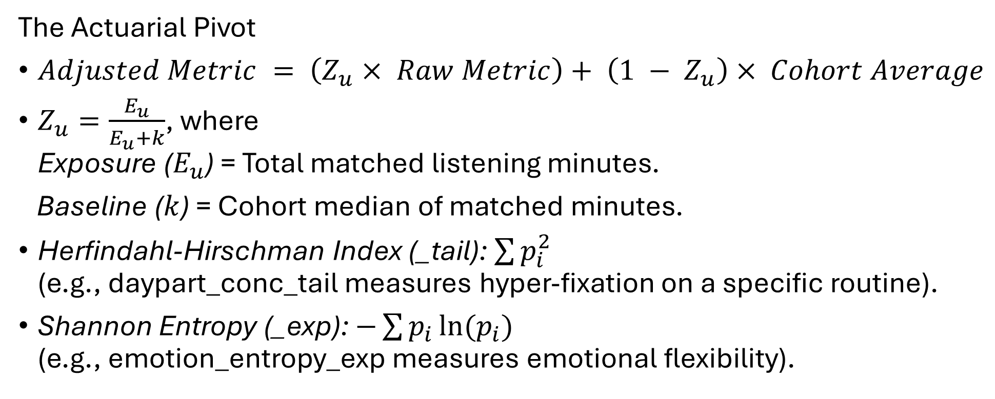
Aggregations and Wrapped
The Actuarial Pivot
$Adjusted Metric = \left(Z_{u}× Raw Metric\right)+ \left(1 − Z_{u}\right)× Cohort Average$
$Z_{u}=\frac{E_{u}}{E_{u}+k}$, where Exposure ($E_{u}$) = Total matched listening minutes.
Baseline ($k$) = Cohort median of matched minutes.
Herfindahl-Hirschman Index (_tail): $\sum{p_{i}^{2}}$ (e.g., daypart_conc_tail measures hyper-fixation on a specific routine).
Shannon Entropy (_exp): $−\sum{p_{i}}ln(p_{i})$ (e.g., emotion_entropy_exp measures emotional flexibility).
Notes:
“How do we calculate $Z_u$? It's simply the student's matched minutes divided by their minutes plus the cohort median. It perfectly captures exposure: the more data we have, the closer $Z_u$ gets to 100%. We adapted economic formulas. Our _tail metrics use the Herfindahl-Hirschman Index to measure if a student hyper-fixates on a specific routine. Our _exp metrics use Shannon Entropy to measure if they have a highly diverse, flexible emotional vocabulary."

Slide 17
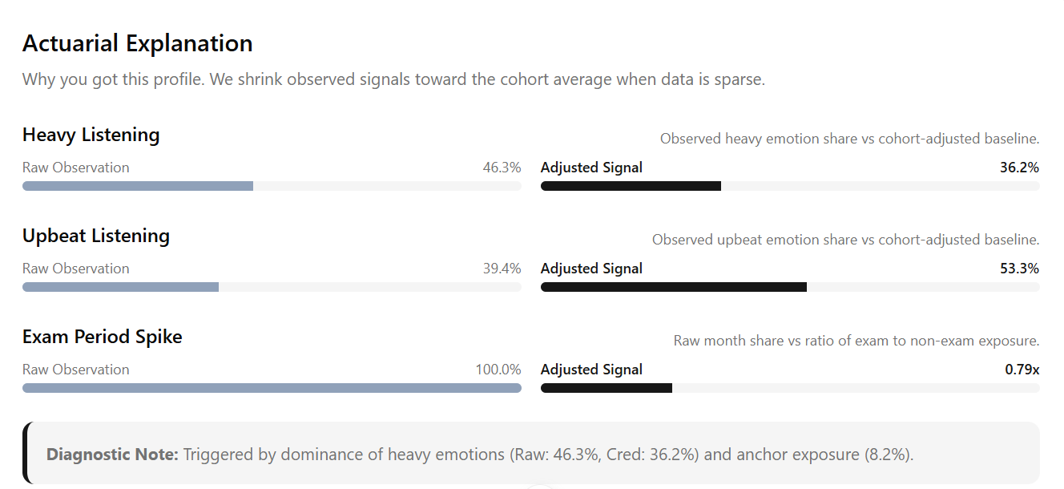
Aggregations and Wrapped
Notes:
"This is the core formula. The adjusted score we use for classification is a blend. If we have high confidence in the student's data, $Z_u$ is high, and their raw data wins the tug-of-war. If confidence is low, $Z_u$ is low, and their score shrinks back toward the cohort average. We implemented a 'Dual-Layer' schema. Every major metric has a _raw suffix representing exactly what we observed, and a _cred, _tail, or _exp suffix representing the actuarial companion. This allows the frontend to compare the two states directly.”

